Slide 1
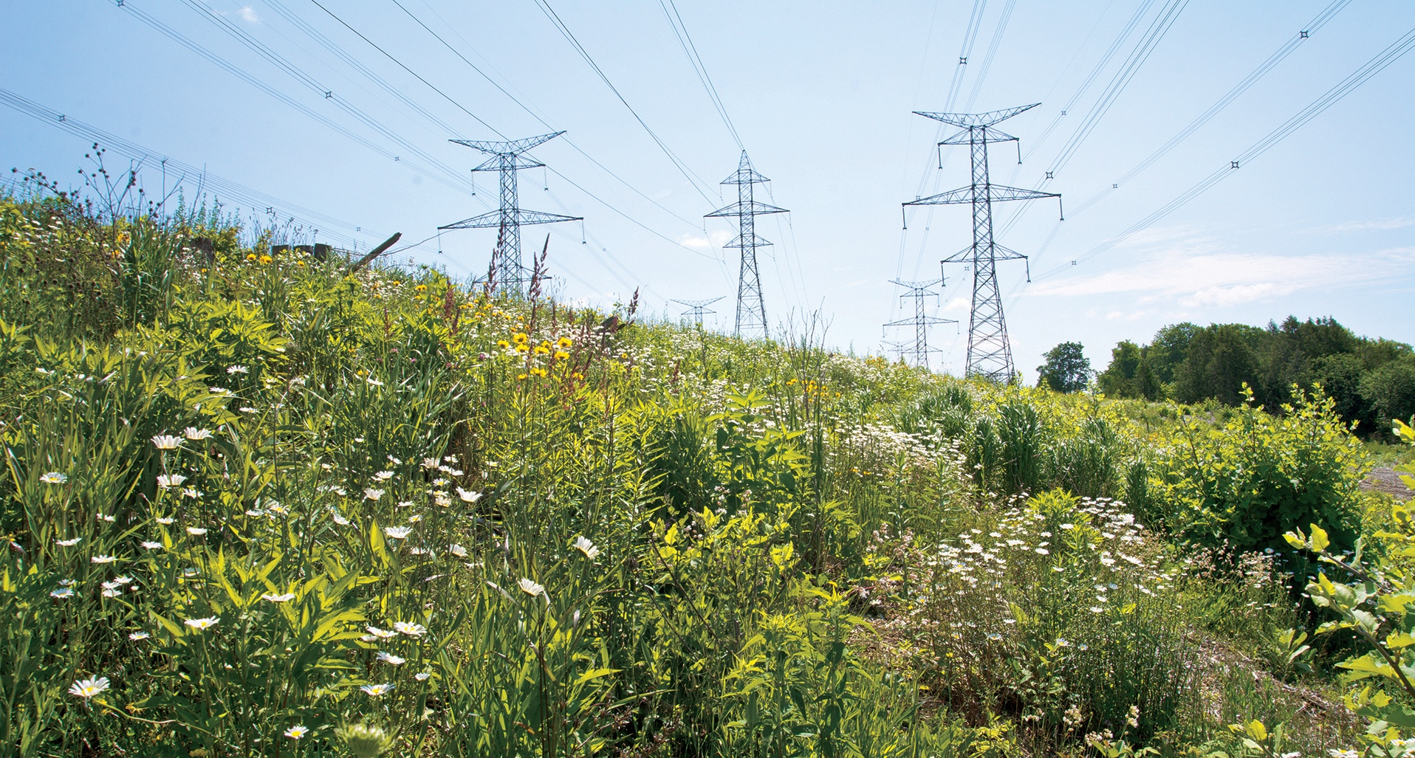
Hydro One and Biodiversity
December 11, 2022

Slide 2
Who we are
Hydro One energizes life for people and communities, helping Ontarians live a better and brighter future.
Hydro One Biodiversity • 2

Slide 3
Biodiversity – a part of our business
To achieve world-class environmental performance and to contribute to a greener Ontario for future generations.
Hydro One Biodiversity • 3

Slide 4
Biodiversity Initiatives
Pollinator Habitat Program
Osprey nest box program
Grey Wolf Research
Brook trout and coldwater stream health monitoring
Turtle habitat / nesting boxes
Wetland restoration
Hydro One Biodiversity • 4

Slide 5
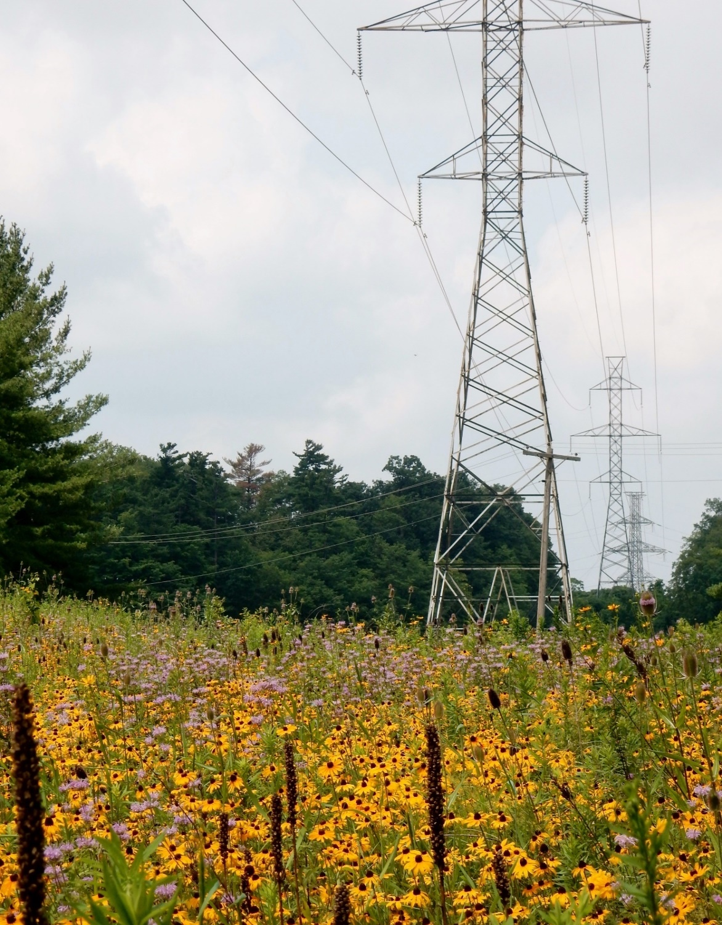
Pollinator Program
Began in 2015
Over 150 hectares planted
Integrated into vegetation management
Environmental Services led restorations
Partnerships
2021 Environmental Excellence Award from Electricity Distributors Association
Hydro One Biodiversity • 5
Hydro One Biodiversity • 5

Slide 6
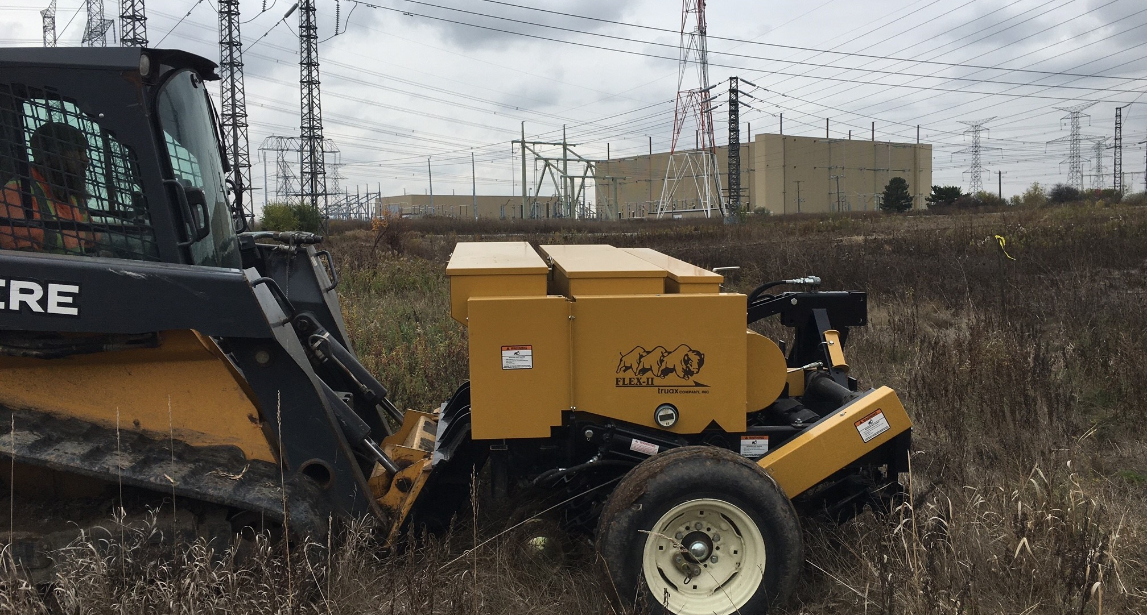
Pollinator habitat planting
Hydro One Biodiversity • 6

Slide 7
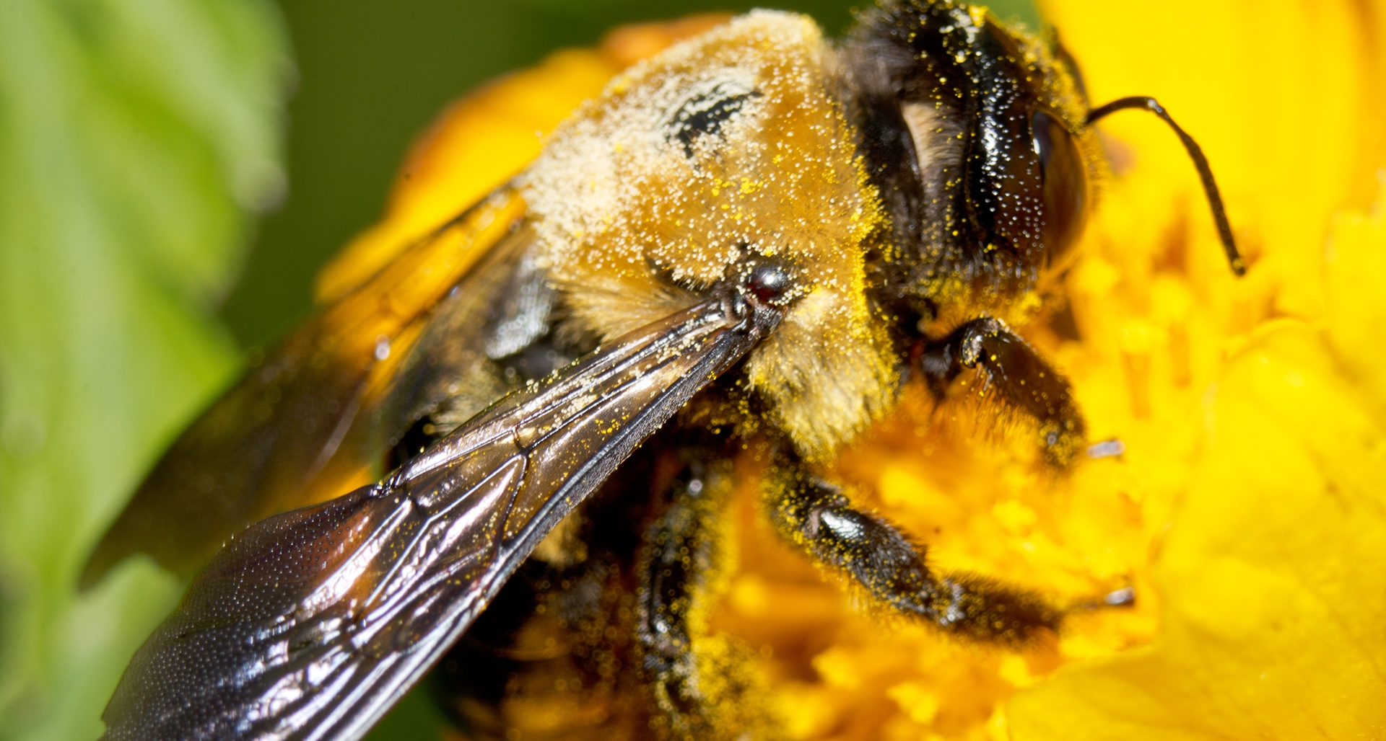
Pollinator Habitat Program
Hydro One Biodiversity • 7
Hydro One Biodiversity • 7

Slide 8
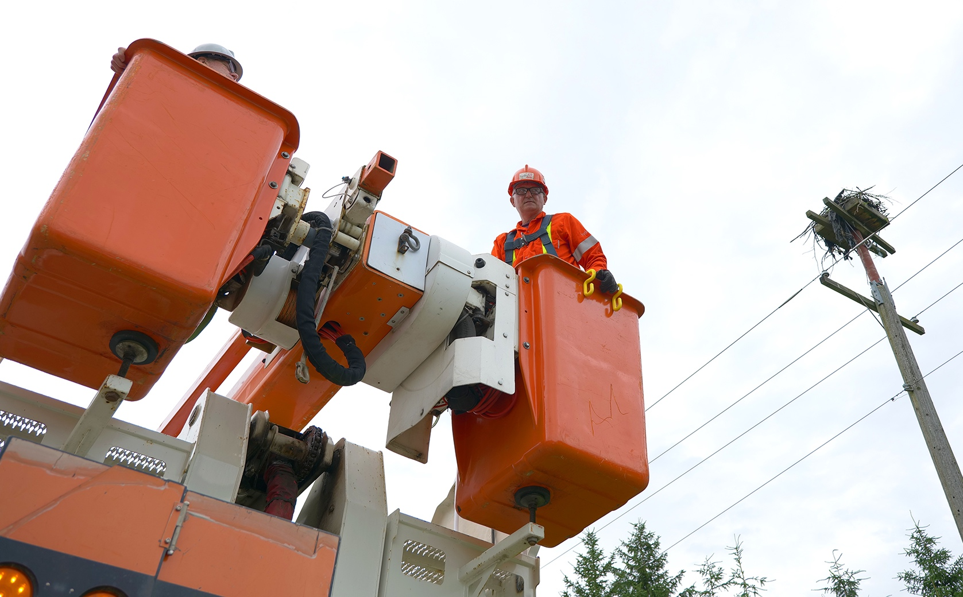
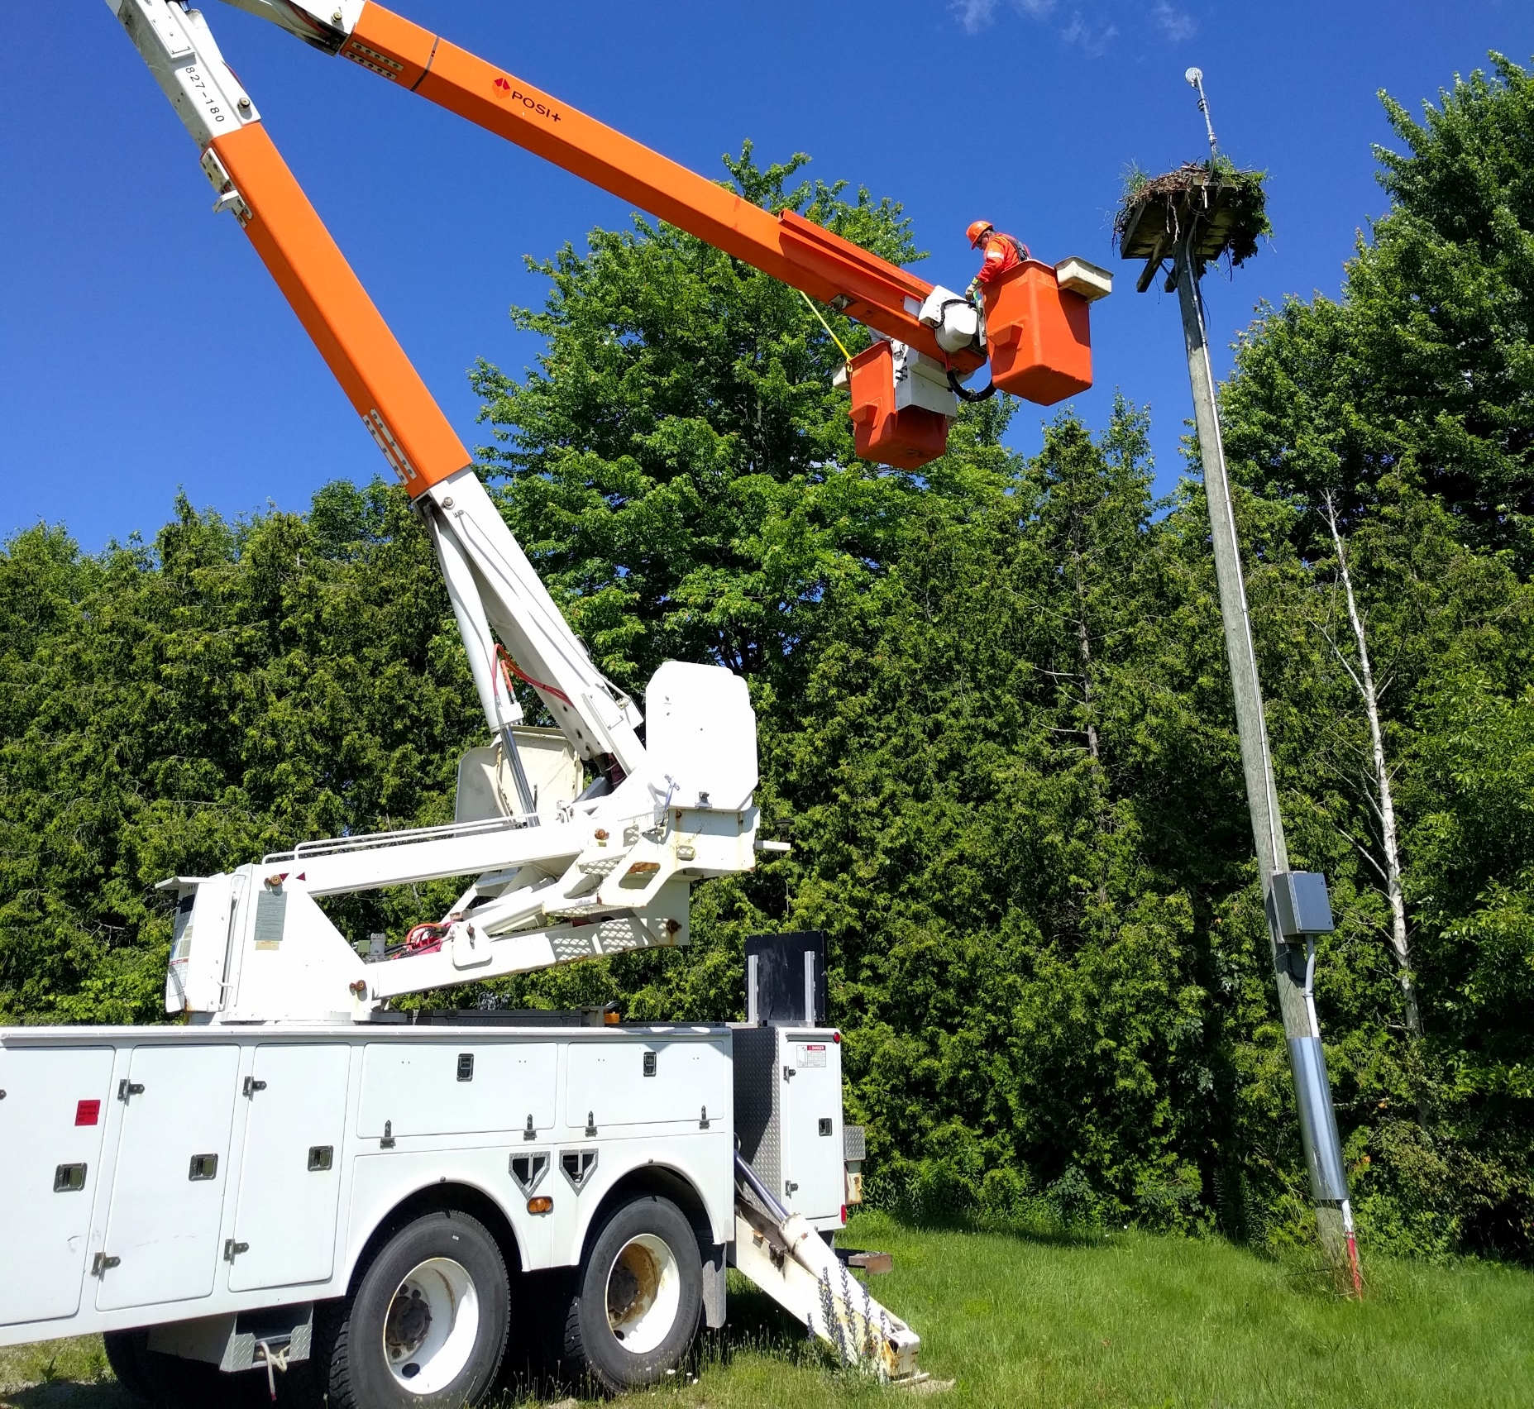
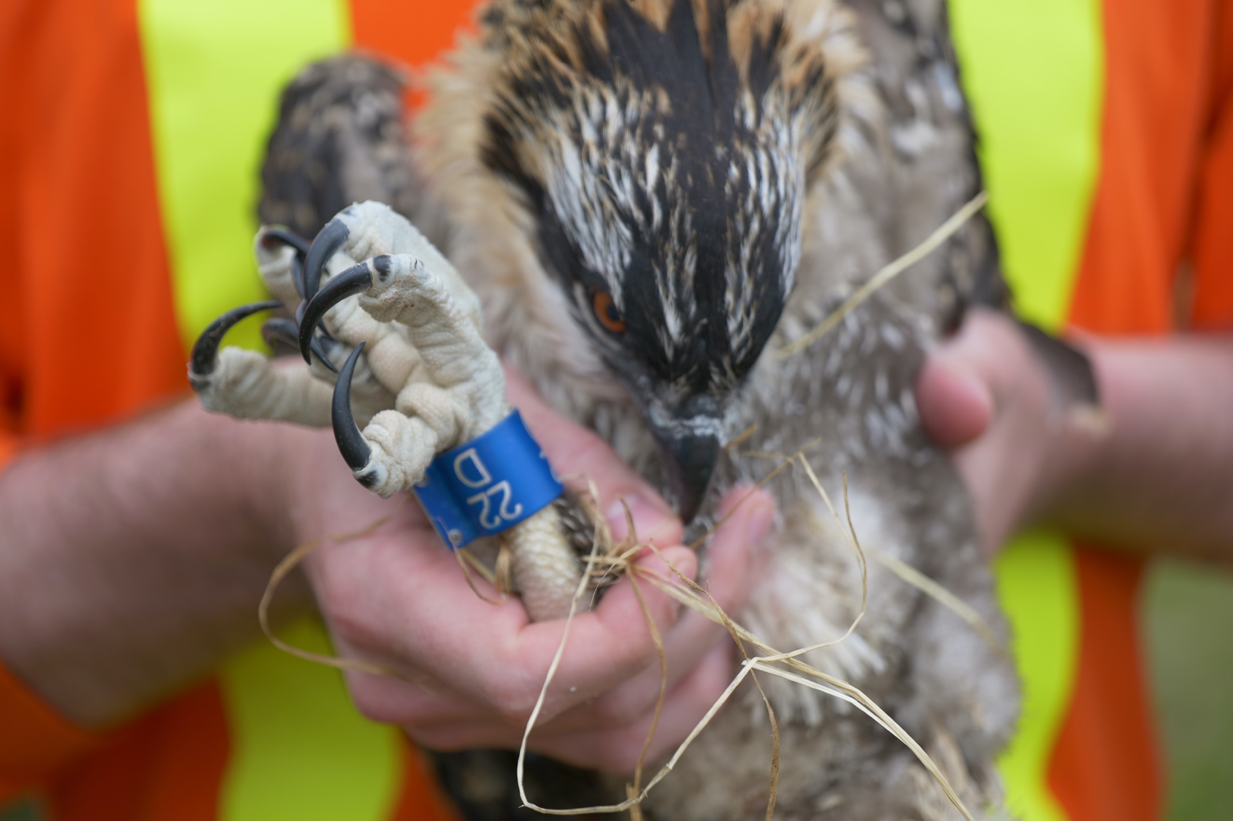
Osprey nest box program
Hydro One Biodiversity • 8
Hydro One Biodiversity • 8
Notes:
Osprey

Slide 9
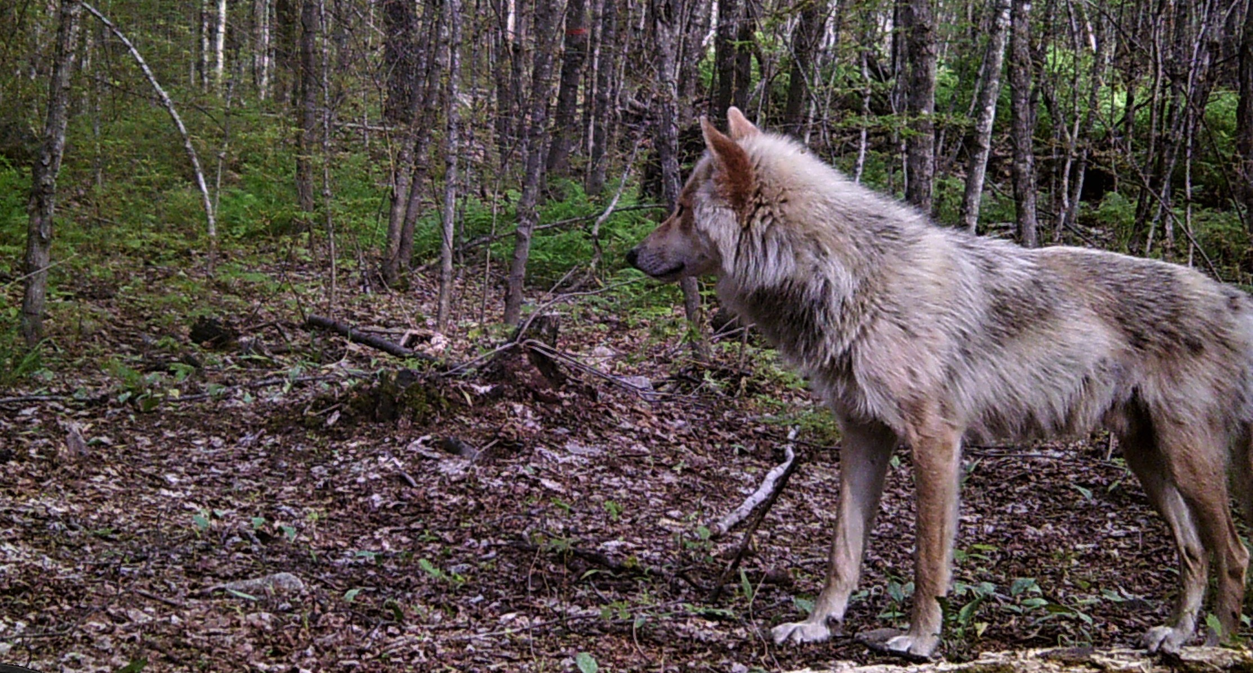
Grey Wolf Research
Hydro One Biodiversity • 9

Slide 10
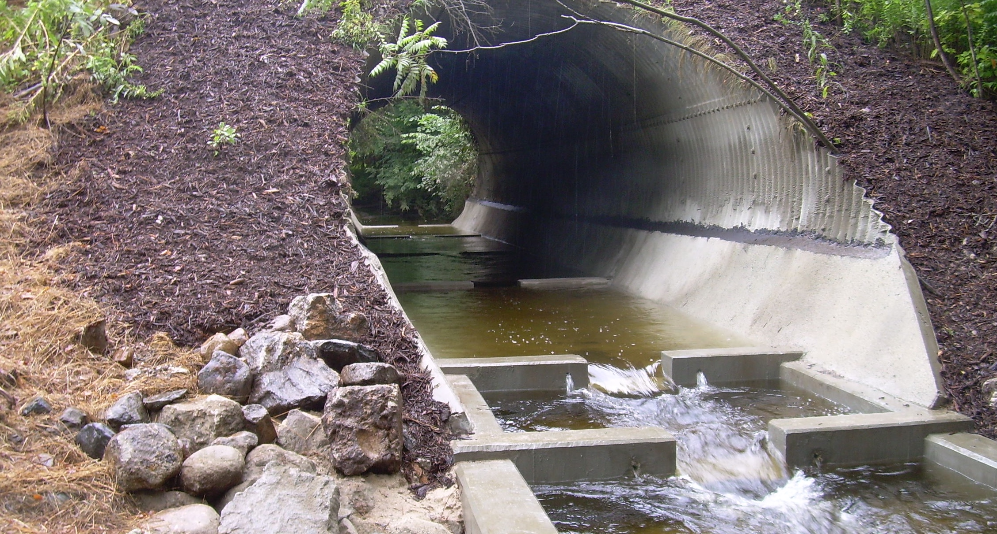
Wesleyville coldwater stream
Hydro One Biodiversity • 10

Slide 11
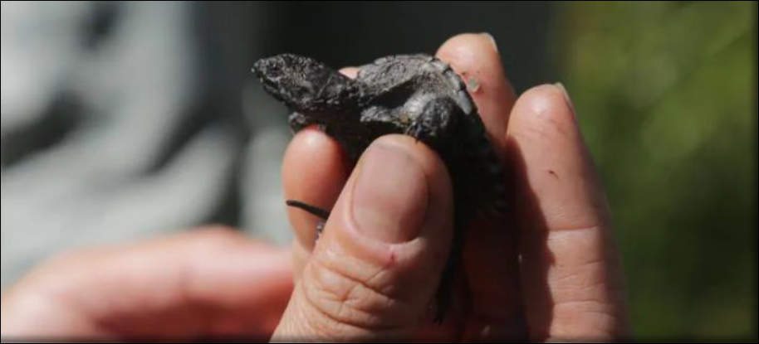
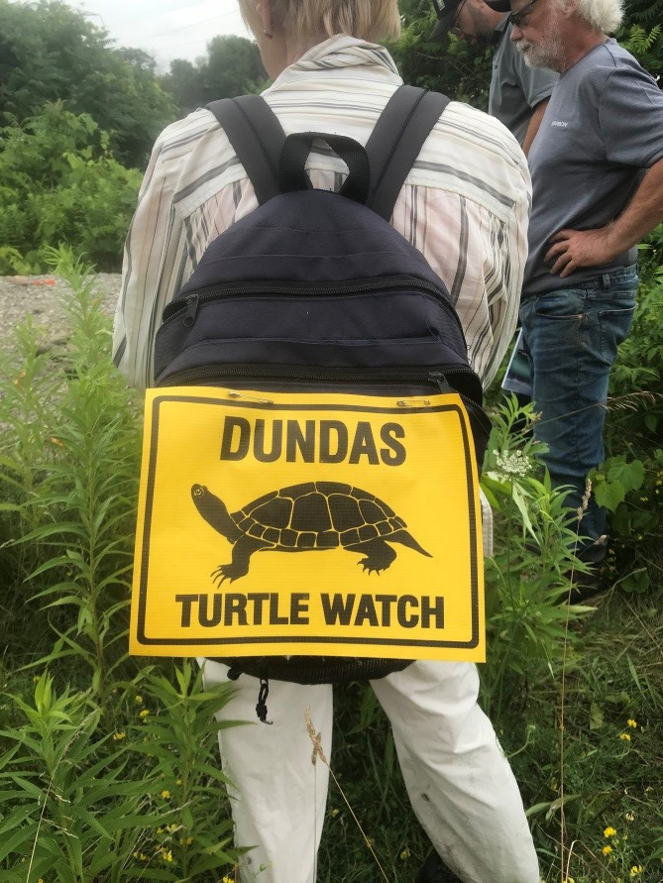
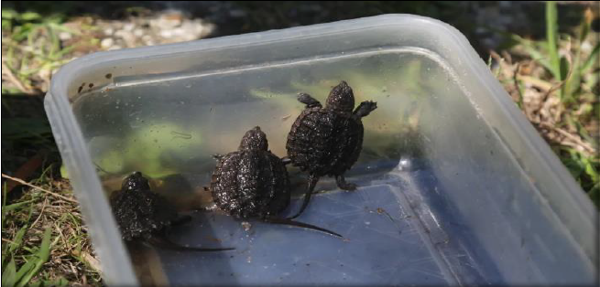
Turtle habitat / nesting boxes
Hydro One Biodiversity • 11

Slide 12
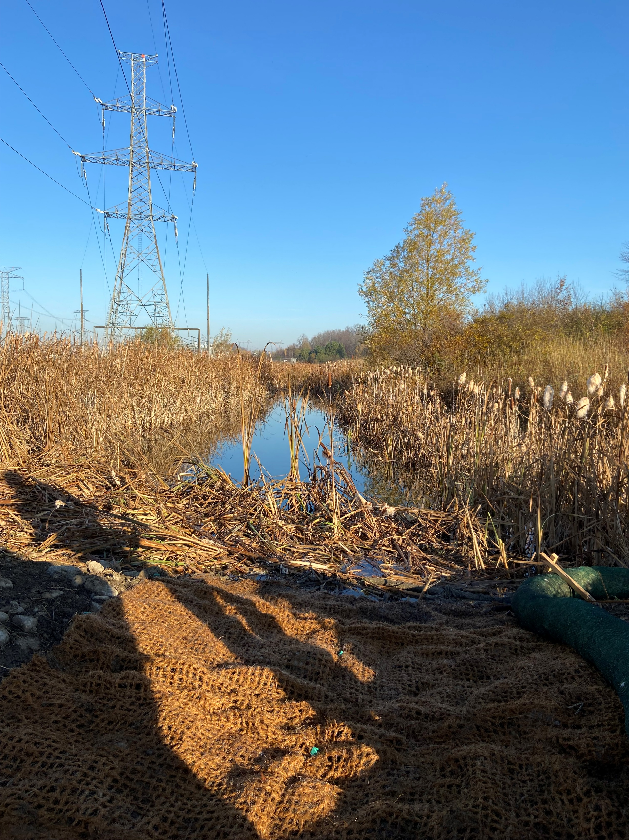
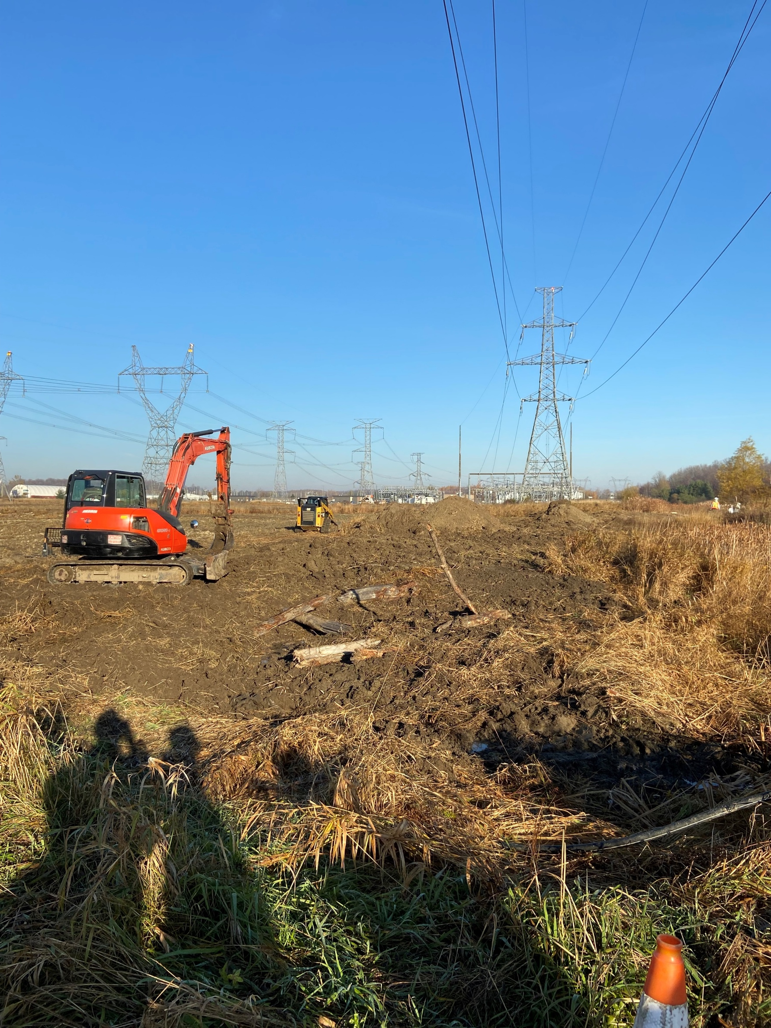
Wetland Creation
Hydro One Biodiversity • 12

Slide 13
Thank you
For more information, please contact us at
Environment@HydroOne.com
Hydro One Biodiversity • 13

